Slide 1

Zomato Market Analysis data
Darshan Patni
19-09-2025

Slide 2
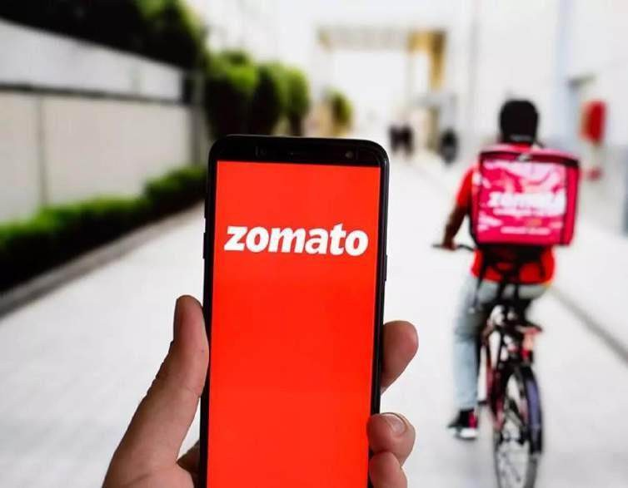
Analysis Objective
Identifying the new countries where Zomato can open new restaurants and expand its business.
Analyzed restaurants ratings and the price range for deeper insights for better decision making .
Analyzed and calculated the expenditure so that we can control our expenditure in the newer restaurants.
Analyzed the cuisines we should go for in the restaurants.

Slide 3
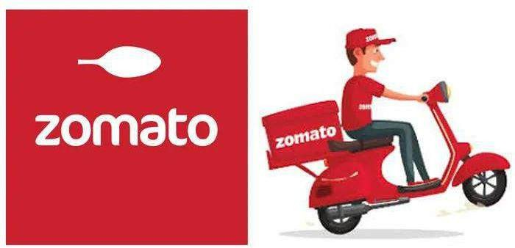
About Zomato
Zomato is an Indian multinational restaurant aggregator and food delivery company. It was founded by Deepinder Goyal and Pankaj Chaddah in 2008.
Zomato charges a 20-25% commission from the particular restaurant for each order placed. In some
regions, the commission rate may vary from 5-7%.

Slide 4
Project Introduction
This project focuses on analysing restaurant data across multiple countries to identify market opportunities for opening new restaurants. The dataset contains detailed information on restaurant locations, cuisines, costs, ratings, delivery options, and customer engagement.
the global restaurant industry is valued at over $4 trillion, yet many cities remain underserved despite high customer demand?
This project leverages real restaurant data to uncover untapped opportunities by analyzing market trends, customer ratings, pricing, and service preferences. The primary goal is to identify potential areas for expansion, understand how services like online delivery and table booking impact feedback, and highlight cuisines that drive customer satisfaction. In doing so, the project provides actionable insights for strategic restaurant growth across diverse markets.

Slide 5
Data summary
Restaurant ID: Unique identifier for each restaurant.
Restaurant Name: The name of the restaurant.
Country Code: Country code of the location
where the restaurant is situated.
City: The city where the restaurant is located.
Address: The specific address of the restaurant.
Locality: The locality or neighborhood where the restaurant is situated.
Locality Verbose: Detailed information about the locality.
Longitude: The geographical longitude coordinate of the restaurant.
Latitude: The geographical latitude coordinate of the restaurant.
Cuisines: The type of cuisine offered by the restaurant.
Currency: The currency used for transactions in the restaurant.
Has Table booking: Indicates whether the restaurant has a table booking option (Yes/No).
Has Online delivery: Indicates whether the
restaurant offers online delivery (Yes/No).
Is delivering now: Indicates whether the restaurant is currently delivering (Yes/No).
Switch to order menu: Indicates whether users can switch to the order menu (Yes/No).
Price range: A numeric value indicating the price
range category of the restaurant.
Votes: The number of votes or ratings/(feedback) received by the restaurant.
Average Cost for two: The average cost for two people dining at the restaurant.
Rating: The overall rating of the restaurant is based on user reviews.
Datekey opening: The date when the restaurant was opened.

Slide 6
Methodology
Data Cleaning & Preparation
Handled missing and zero values in cost, ratings, and cuisines.
Standardized categorical data (e.g., country names, cuisines) for consistency.
Converted cost columns into a clean numeric format for analysis.
Data Enrichment
Created new fields like price range categories and grouped cuisines for comparison.
Merged country codes with full country names for better readability.
Analytical Techniques
Descriptive Analysis: Explored average ratings, cost distributions, and delivery/table booking availability.
Trend Analysis: Identified country- and city-wise restaurant growth and service adoption.
Correlation Checks: Studied relationships between cost, ratings, and services offered.
Tools & Features Used
Excel: Pivot tables for summarizing restaurant counts, VLOOKUP for mapping country codes, charts for visualization.

Slide 7
Number of restaurants in each country
From the chart we can analyze that in India there are more numbers of restaurants i.e. 8652 we can say that almost 90% of the market is being occupied by India so the competition is very high there.
In the countries like Canada , South Africa, Indonesia, Philippines, Qatar, Singapore, and Sri Lanka the market saturation is very low so I’ll suggest to open up for the newer restaurant in these countries as by opening the restaurants we can develop a great market share for the restaurants .

Slide 8
Total count of restaurants
opened per year
We can analyze the trend and predict in the next year how many restaurants will open probably.
As from 2015 we see a steady growth over the years so we can say the trend will continue.

Slide 9
Country wise average
Number of voters
Indonesia has the highest voters with 772 votes followed by UAE and USA with 494 and 428 votes respectively .
Brazil has the least number of voters with 20 votes.
Here we can observe that even the countries having highest number of restaurants the number of voters can less or vice versa.
For example, India has the highest number of restaurants 8652 but it only have 137 votes.

Slide 10
Country vs Average Rating
Philippines has the highest rating of 4.47 followed by Indonesia with a rating of
4.30.
Canada and Singapore has least rating with 3.58 rating.
The ratings are quite good for these countries so as per the data it can be a good decision if we go for restaurant expansion in these countries.

Slide 11
Price range distribution
Price Range Count of Restaurants
1 | 4443
2 | 3113
3 | 1408
4 | 586
Grand Total | 9550
In this chart we see the price range distribution in the range of 1 to 4.
We see that 46% of restaurant falls under the price range of 1
whereas only 6% of the restaurants falls under the price range of 4.

Slide 12
Percentage of restaurants having online delivery
Percentage of restaurants having table booking
Here we can see the two charts which shows the count of the restaurants offering for table booking and online delivery.
We can see that 26% of the restaurants provides online delivery rest 74% do not offer any online
delivery service.
While in the chart 2 we see that only 12% of the restaurants offers for table booking rest 88% do not offer any table booking.
So if in our new restaurants we go for online delivery and table booking then it can be a good strategy .

Slide 13
Country wise Average cost of two in INR
This chart gives us the average expense for two person country wise.
This gives us proper control over the expenditure on the food.
With this also we will get the idea at what expense we need to open the new restaurant.

Slide 14
Country wise top Cuisines
This chart gives us the top cuisine based on the rating given by the customer.
This gives us proper control over the cuisines that we need to provide to the customer in the new restaurant.

Slide 15
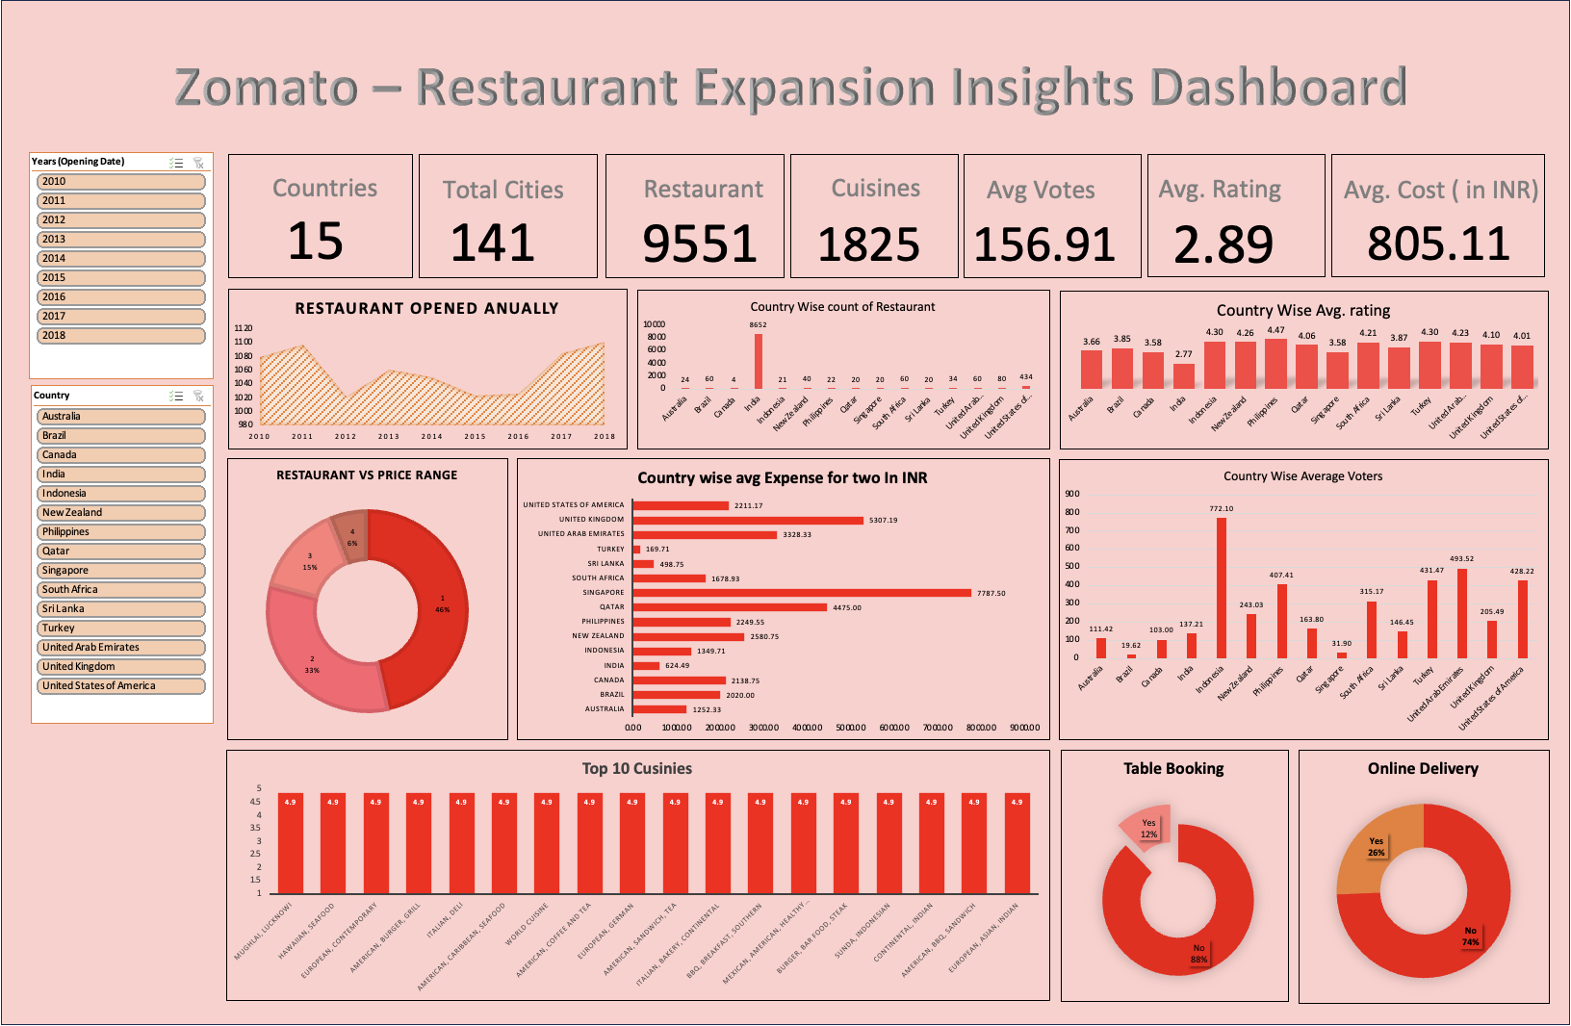

Slide 16
Recommendation
Countries Shortlisted:-
South Africa
Brazil
Philippines
Indonesia
Canada

Slide 17

Conclusion
Analyzed the data and identified countries where newer restaurants can be opened.
Identified the states and the cities where we can open the restaurant within the suggested country on the basis of the average cost , ratings , no. of restaurants already opened there , price range etc.
All these cities has the highest average cost for two and less market saturation that means less competition.

Slide 18

Reference
Raw data is provided by
Newton School team.
Used MS Excel, MS Word, MS PowerPoint to complete this project.

Slide 19








Thank you for Your Time!

